Slide 1



Hi-tech Rehab Centre
(A Unit of medi India Pvt. Ltd.)

Slide 2
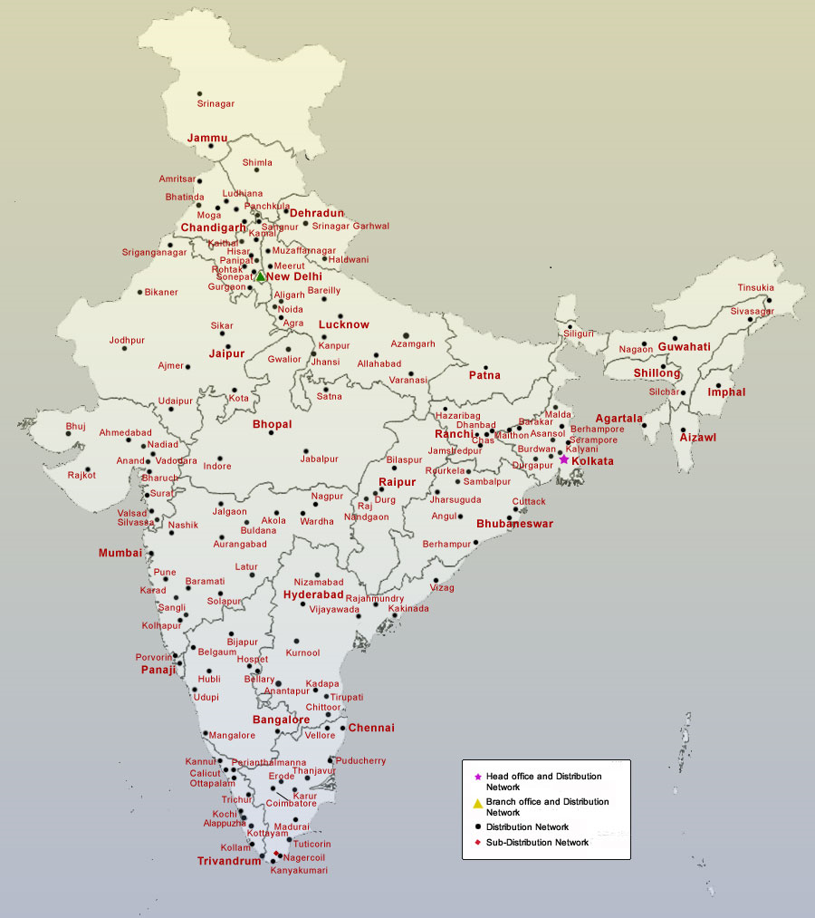

PHRC Location & PMIPL Network
HQ: Kolkata
Distribution Network:
Cities > 175
Distributor > 425

Slide 3

Prosthetics & Orthotics
Future Mobility ensuring enhanced quality of life

Slide 4

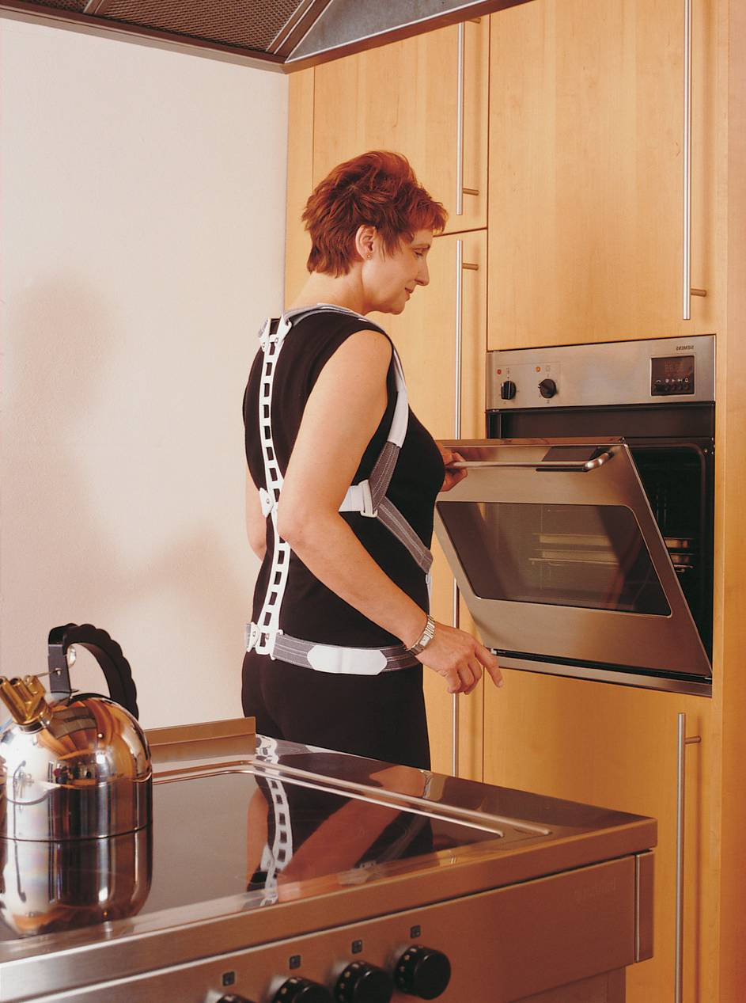
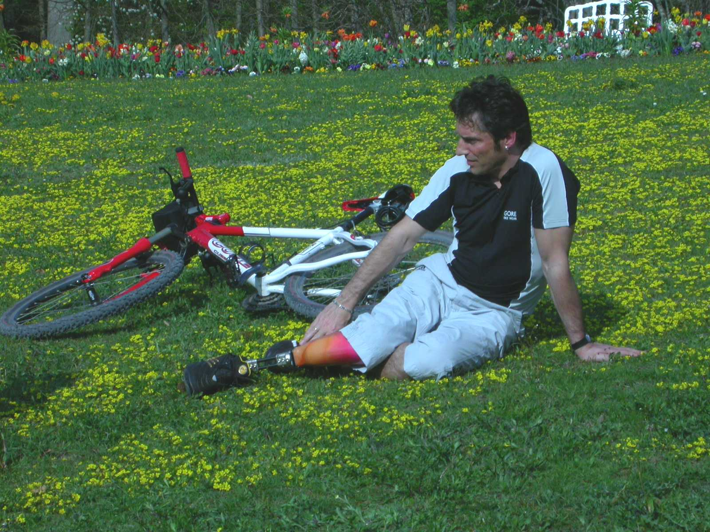
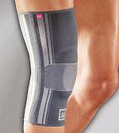
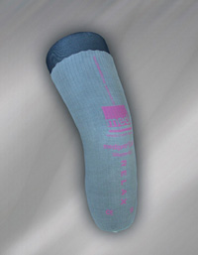
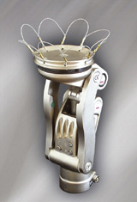
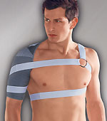
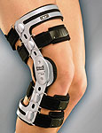
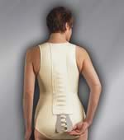
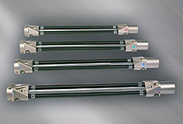
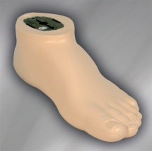
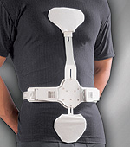
Products of medi®
mediortho®
medipro®
Genumedi
Knees
Omomed
Liners
M4
Spinomed
Clever Bone
Feet
3C
medi.I feel better

Slide 5

Innovative diverse Prosthetic & Orthotic range
medipro
Stump Shrinker
Definitive prosthesis
Fabrication/
Assembling
Gait training
Comfort SCS
Foot
Tibial components
Socket
Adapters
Suspension
Liner/socks
Joints
medi.I feel better

Slide 6
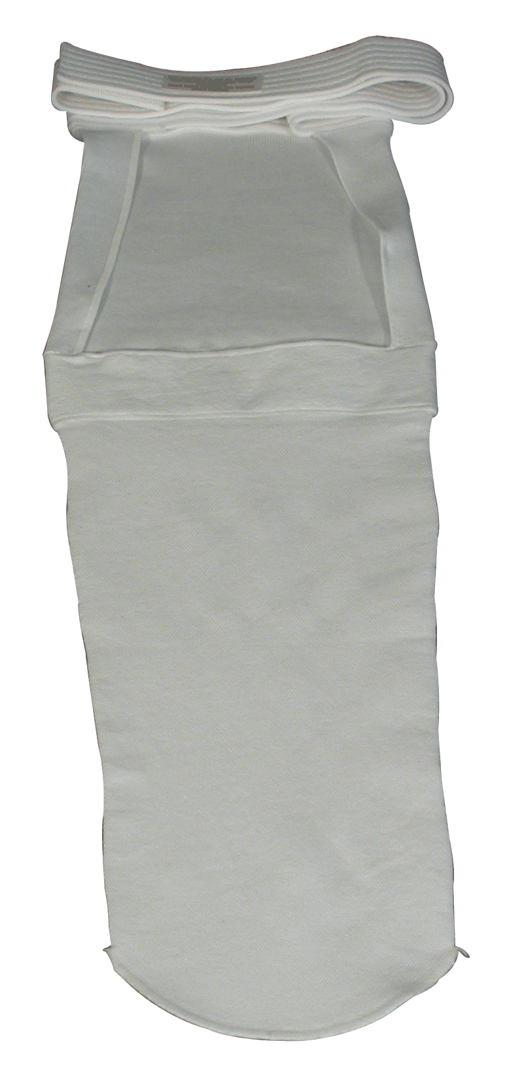
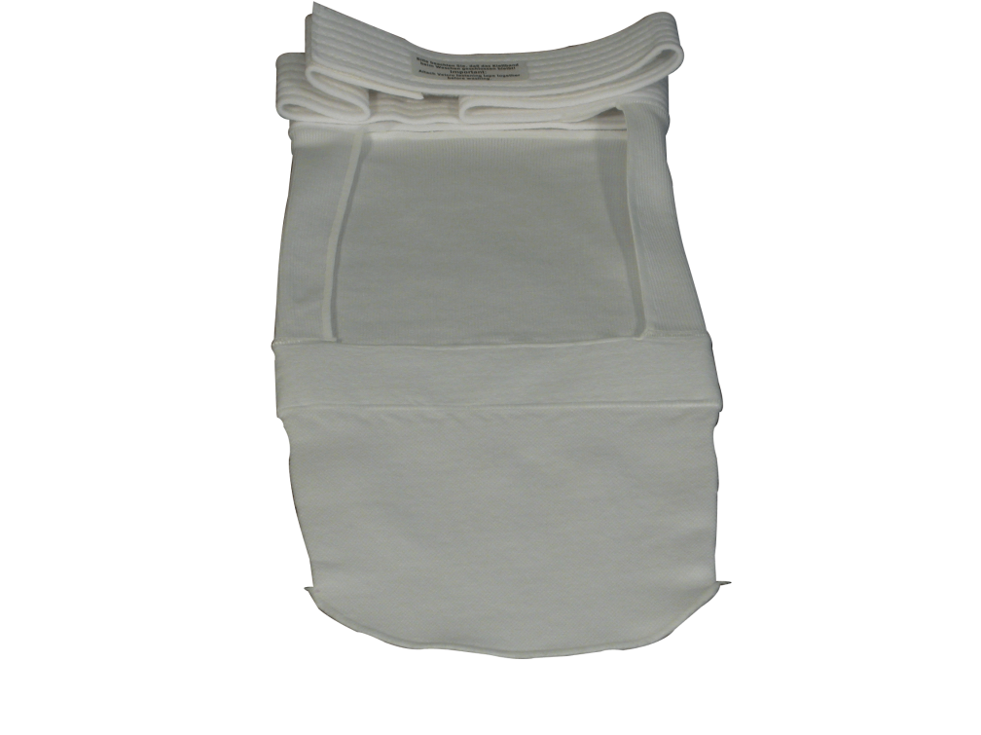


Stump Shrinkers
Gradual compression stockings for amputees
Function
Below knee amputee
Heals internal wound
Above knee amputee
control swelling (edema) in the residual limb
Applied as an alternative to bandage
Types

Slide 7
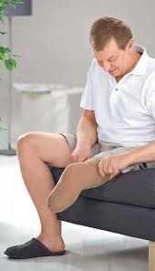
Comfort SCS
a new generation of Stump Shrinkers
Indication
Features
Technical specification
Fixing soft tissue
Movable waistband
Post-traumatic swelling after amputation or pre prosthetic care
Skin friendly
Secure hold
Compression class II
Length: 32cm
Reduction in swelling after amputation
Silicone beaded BK top band
Two versions: BK and AK
Rs. 2263(AK)
Rs. 2389(BK)
medi.I feel better

Slide 8
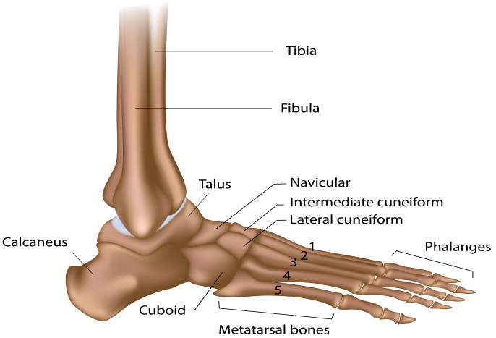
Anatomy & Function
Foot
SACH
Single axis
Panthera CFI
Panthera CFII
Dynawalk MI
medi.I feel better

Slide 9
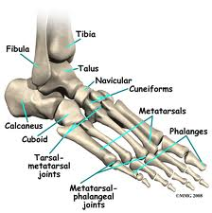
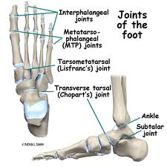
Human feet - Anatomy
26 bones & >20 muscles
Sub-talar, mid-tarsal, first metatarso-phalangeal joint
Results in many complicated & useful movements
Permits flexion-extension, inversion-eversion
Helps to stand & balance base
Transfers body weight to ground
Adaptation in special circumstances
Flexibility help us to negotiate uneven terrain
Helps to propel forward-action of muscles

Slide 10
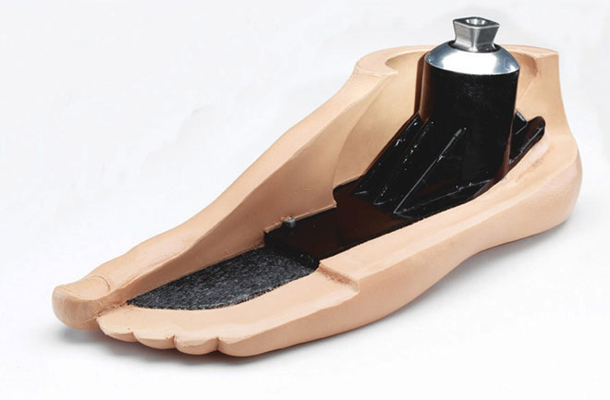
Prosthetic feet-functions
Artificial ankle/foot for amputees
Function
Type
Provide a platform for construction of rest of the prosthesis
SACH Foot
Single axis
Dynamic foot
Withstands body weight
Flexibility to accommodate uneven terrain
Offers smooth roll over during stance phase
Carbon foot

Slide 11
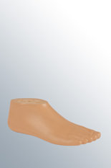

medi SACH foot
Prosthetic foot for less mobile user
Indication
Features
Technical specification
Damping heel strike
Lower limb amputation
Mobility class I
Weight limit: 100 kg
Weight: 450gm
Total fitted height: 75mm
High need of safety
Safe and stable
Heel height: 10 mm
Natural look with molded toe
Material: PU/wooden core
Rs. 3973
medi.I feel better

Slide 12

medi single-axis foot
Prosthetic foot with ankle joint function
Indication
Features
Technical specification
Lower limb amputation
Basic ankle joint function
Mobility class I & II
Weight limit: 100 kg
Weight: 570 gm
Total fitted height: 60mm
Need of safety
Quick, even & safe ground contact
Heel height: 10 mm
Natural look with molded toe
Material: PU/Steel
Rs. 9551
medi.I feel better

Slide 13

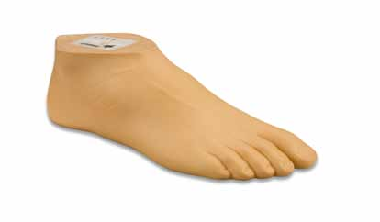
medi DynaWalk M1
Prosthetic foot with with soft heel and a soft forefoot to satisfy the demands of patient with low mobility
Indication
Features
Technical specification
Lower limb amputation
Soft heel and forefoot
Mobility class I and II
Weight limit: 100 kg
Weight: 475 gm
Total fitted height: 75mm
Need of safety
Heel height: 10 mm
Material: PU/POM
waterproof
Natural look with split toe
Rs. 6671
medi.I feel better

Slide 14
medi panthera CF I
Combines the benefits of a comfortable elastomer foot with the dynamic properties of a carbon spring foot
Indication
Features
Technical specification
Lower limb amputation
Mobility class II and III
Weight limit: 136kg
Weight: 650 gm
Energy return system
Degree of hardness: 1-4
Material: carbon, elastomer, steel
Continuous carbon spring
Integrated heel buffer with pivot principle
Multiple layer
Fitted height: 120mm
principle with intermediate elastomer layer
Rs. 62202
medi.I feel better

Slide 15
medi panthera CF II
Combines the benefits of a comfortable elstomer foot with the dynamic properties of a carbon spring foot
Indication
Features
Technical specification
Lower limb amputation
Mobility class III and IV
Weight limit: 136kg
Weight: 136 gm
Energy return system
Material: carbon, elastomer, steel
Continuous carbon spring
Integrated heel buffer with pivot principle
Multiple layer principle with intermediate elastomer layer
Fitted height: 120mm
On request
medi.I feel better

Slide 16
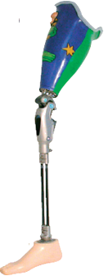
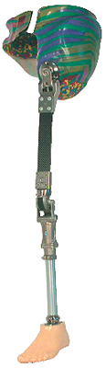
Joints
Knee
Mechanical
Pnuematic
Hydraullic
Hip
HM3
medi.I feel better

Slide 17
Anatomy & Function
Knee
Mechanical
Hydraulic
Pneumatic
Monolock SE
Haiti
OM8
OFM2
OFM1/KFM1
OP2 SE
OP4
OP5/KP5
OHP3/KHP3
OH5/KH5
OH6/KH6
medi.I feel better

Slide 18
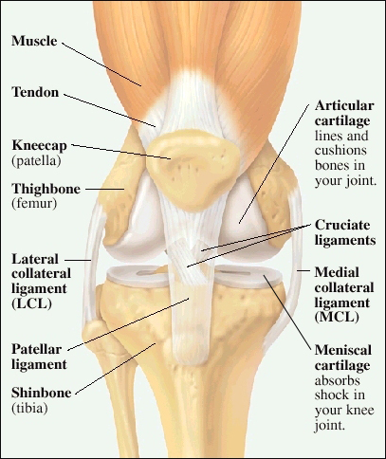
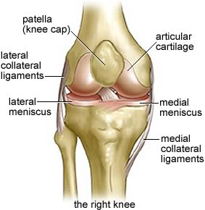
Human knee – An understanding
Three bones: the femur, tibia, and patella, as well as ligaments, tendons and numerous bursae, or fluid-filled sacs
There are two menisci located
The knee joint is surrounded by a joint capsule
Two intersecting ligaments(ACL and PCL) are located
Permits flexion-extension & limited rotation
Stand & walk at different speed
Negotiate obstacles/terrain
Situational adaptation (sports, ADL)
Movement under load

Slide 19
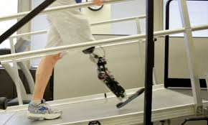
Prosthetic knee- functions
Artificial knee joint for amputees
Function
Types
Extension/flexion control
On basis of structure:
Withstands body weight
Compromises between stability & mobility
Safety during standing and walking
Monocentric
polycentric
  On basis of Function:
    Mechanical
    Pnuematic
    Hydraulic

Slide 20
Knee swing phase: basic information
Swing phase control systems
mechanical
internal/ external assist
friction
fluid systems
hydraulic
pneumatic
Copyright © 2015 Pushpanjali medi India Pvt. Ltd. All Rights Reserved

Slide 21
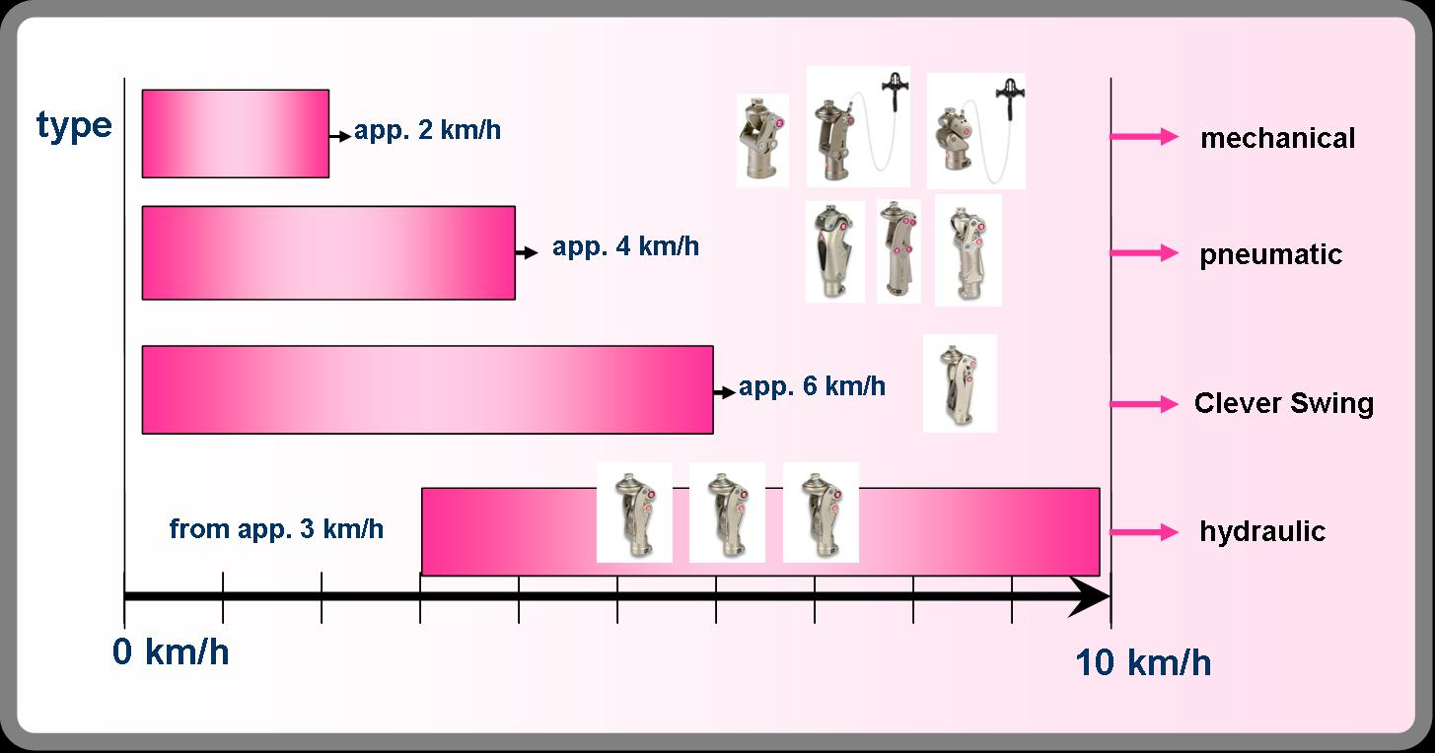
Swing phase control - performance
medi.I feel better
Copyright © 2015 Pushpanjali medi India Pvt. Ltd. All Rights Reserved

Slide 22
medi monolock SE
Locking knee joint, monocentric
Indication
Features
Technical specification
Above knee amputation
Mobility class I
Weight limit: 125 kg
Weight: 275gm
Flexion angle: 140º
Overall fitted height: 100 mm
Material: Aluminium
Light weight
Secure and safe
Optional release of knee flexion
Rs. 13488
medi.I feel better

Slide 23
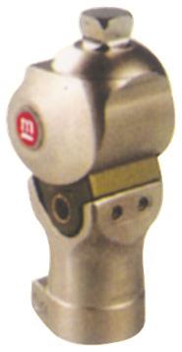
medi Haiti knee
Mechanical knee joint with brake function, monocentric
Indication
Features
Technical specification
Above knee amputation
Integrated extension spring
Mobility class I and II
Weight limit: 100 kg
Weight: 450gm
Flexion angle: 150º
Overall fitted height: 120 mm
Material: Aluminium
Adjustable brake
Rs. 41967
medi.I feel better

Slide 24
medi OM8 SE
Mechanical polycentric knee joint
Indication
Features
Technical specification
Above knee amputation
Adjustable axle geometry
Mobility class I or II
Weight limit: 136 kg
Integrated extension spring
Adjustable axle friction
Weight: 450gm
Flexion angle: 160º
Overall fitted height: 128 mm
Material: Aluminium
Rs. 29198
medi.I feel better

Slide 25
medi OFM2
Mechanical monocentric knee joint with break function and 2-in-1 function
Indication
Features
Technical specification
Adjustable brake
Above knee amputation
Locked knee
Mobility class I or II
Weight limit: 125 kg
Integrated extension spring
Weight: 495gm
Flexion angle: 145º
Overall fitted height: 115mm
Rehabilitation knee joint
Material: Aluminium
Rs. 42542
medi.I feel better
Ref. Video

Slide 26
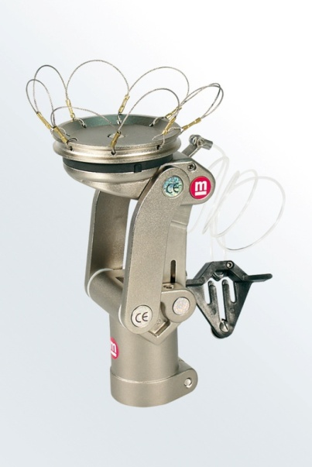
medi OFM1/KFM1
Mechanical polycentric knee joint with 2-in-1 function
Indication
Features
Technical specification
Adjustable axial friction
Above knee amputation
Locked knee
Mobility class I or II
Weight limit: 136 kg
Integrated extension spring
Material: Aluminium
Rehabilitation knee joint
4 different socket connection
Overall fitted height: depends on socket adapter( ranges 150-173mm)
Flexion angle: 145º
Weight: depends on socket adapter( ranges 590-720 gm)
Rs. 46089
medi.I feel better

Slide 27
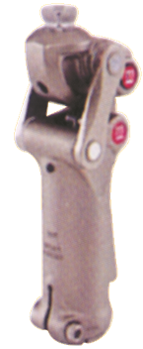
medi OP2 SE
Pnuematic monocentric knee joint ,polycentric
Indication
Features
Technical specification
Above knee amputation
Integrated pivot and shift function
Mobility class II and III
Weight limit: 100 kg
Weight: 650 gm
Flexion angle: 160º
Overall fitted height:190mm
Material: Aluminium
Adjustable axial geometry
Rs. 44065
medi.I feel better

Slide 28
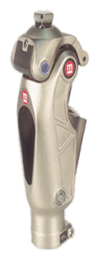
medi OP4
Pnuematic monocentric knee joint with finely adjustable brake unit
Indication
Features
Technical specification
Above knee amputation
Adjustable brake unit
Mobility class II and III
Weight limit: 100 kg
Weight: 680 gm
Flexion angle: 145º
Overall fitted height:198mm
Material: Aluminium
Extension/flexion can be set independently
Rs. 90747
medi.I feel better

Slide 29
medi OP5/KP5
Pnuematic polycentric knee joint with finely adjustable extension and flexion valves
Indication
Features
Technical specification
Above knee amputation
Mobility class II and III
Weight limit: 125 kg
Weight: depends on socket adapter( ranges 770-900gm)
Flexion angle: 145º
Overall fitted height: depends on socket adapter( ranges 195-210mm)
Material: Aluminium
Extension/flexion can be set independently
4 different socket connection
Rs. 90489
medi.I feel better

Slide 30
medi OHP3/KHP3
Pnuematic polycentric knee joint with variable stance phase dynamics
Indication
Features
Technical specification
Above knee amputation
Mobility class II and III
Weight limit: 125 kg
Weight: depends on socket adapter (ranges 875-1005gm)
Flexion angle: 145º
Overall fitted height: depends on socket adapter( ranges 200-225mm)
Material: Aluminium
Optional closing geometry
Extension/flexion can be set independently
4 different socket connection
Integrated pivot and shift function
Variable axle geometry
Rs. 135268
medi.I feel better

Slide 31
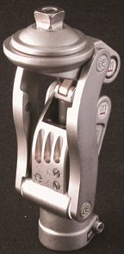
medi OH5/KH5
Polycentric knee joint with 3 valve hydraulic
Indication
Features
Technical specification
Above knee amputation
Mobility class III and IV
Weight limit: 100 kg
Weight: depends on socket adapter( ranges 830-965gm)
Flexion angle: 150º
Overall fitted height: depends on socket adapter( ranges 176-199mm)
Material: Aluminium
closing geometry
4 different socket connection
Integrated pivot and shift function
Rs. 184925
medi.I feel better

Slide 32
medi OH6/KH6
Polycentric knee joint with 3 valve hydraulic
Indication
Features
Technical specification
Above knee amputation
Mobility class III and IV
Weight limit: 136 kg
Weight: depends on socket adapter( ranges 830-965gm)
Flexion angle: 150º
Overall fitted height: depends on socket adapter( ranges 176-199mm)
Material: Aluminium
closing geometry
4 different socket connection
Integrated pivot and shift function
Rs. 212677
medi.I feel better

Slide 33
medi HM3
Mechanical monocentric hipjoint with adjustable swing and stance phase behaviour, particularly efficient in combination with the medi ESSA system
Indication
Features
Technical specification
Pelvic level amputation
Mobility class I, II,III, and IV
Weight: 865 gm
Flexion angle: 140º
Material: Aluminium, Titanium
Adjustable extension function and stop
Weight limit: 100 kg
3 dimensional adjustment radius
Comes with ESSA
exchangeable extension bumpers in 18°, 25°and 33°
Rs. 98047
medi.I feel better

Slide 34
Tibial Component
Function
Replicate our thigh bone or shin bone
Exoskeleton
Types
Endoskeleton
Transfers weight from socket to the foot-ankle
provide structural support to prosthesis
medi Tibial component
Pylon
Clever bone
ESSA
Double adapter
medi.I feel better

Slide 35
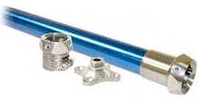
medi Pylon
Energy storing and returning system
Indication
Features
Technical specification
Lower limb amputation
Mobility class I, II, III & IV
Material: Stainless steel
Stability while standing and walking
Amputation level: bellow knee/above knee
Max system length: 41.5
Min system length:
Rs. 4773(SS)
Rs. 8968(TiAl)
medi.I feel better

Slide 36
medi Clever Bone
Energy storing and returning system
Indication
Features
Technical specification
Lower limb amputation
Mobility class I and II
Weight limit: 100kg
Energy return system
Material: Carbon,Elastomer
Stability while standing and walking
Allows torsional movement up to 7º
Amputation level: bellow knee/above knee
Max system length: BK:37cm, AK:35.5cm
Min system length: BK:15 cm, AK:14cm
Rs. 29948
medi.I feel better

Slide 37
medi ESSA
Energy storing and returning system
Indication
Features
Technical specification
Lower limb amputation upto pelvic region
Mobility class I , II, III and IV
Weight limit: 100kg
Energy return system
Material: carbon fiber
Stability while standing
Amputation level: bellow knee/above knee
Max system length: 35 cm
Min system length: 15 cm
facilitates even and steady walking alike the physiological gait
Available in four degrees of hardness
Rs. 24788(strut)
medi.I feel better

Slide 38
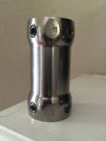
medi Double adapter
A substitute for tibial component
Indication
Features
Technical specification
limitted fitting space
substitute for tibial component
Material: Titanium
Amputation level: below knee
Max system length: 75mm
Min system length: 32mm
4 different heights available: 32mm, 45mm, 60mm, 75mm
Mobility class I, II, III and IV
Rs.5318(32mm)
Rs. 5943(45mm)
Rs. 7464(60mm)
Rs. 9041(75mm)
medi.I feel better

Slide 39
Fabrication/Assembling
Socket
Adapter
Liner or Socks
Socks
Socket
AKOS TFS/TFC
For Phantom pain
Tibial
Foot
Suspension
IKF
Vaccu valve
Genu sleeve
valve set
Modular clutch lock
Soft C
Silicone pad
Sliding
medi.I feel better

Slide 40
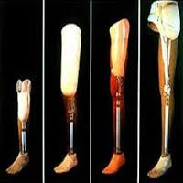
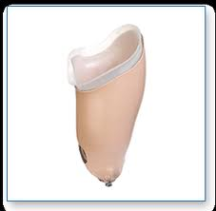
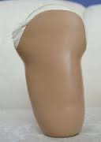
Socket
Most proximal component of the prosthesis
Anatomically contains the residual limb & bears body weight
Connection to rest of prosthesis
Distributes forces along distal component
Provides sensory information to control the prosthesis
May help in anatomical suspension
Most vital part of a prosthesis
distributes load to pressure-tolerant tissues
relieve pressure on sensitive areas.

Slide 41
Revolution of transtibial socket
0pen ended
Peg leg
Conv. wooden type
Cane prosthesis
PTB
&
its variants
TSB
-HSD
-3S
Pump it up design
Notes:
Conv- metal, leather, wood PTB- thermoplastic, thermosetting resins silicon suction socket (3s & ICEROSS) – composite & flexible mat.
(1950s by Radcliffe & Foort, 1961) (gel liners) based on loading principle not only incorporates HSD &
TSB but also enhanced suspension technique.

Slide 42
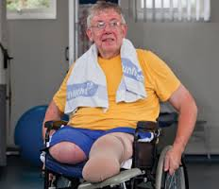
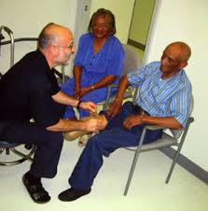
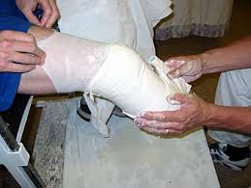
Assessment & Measurement
Residual limb assessment
Psychological consultation
Casting - replica of affected site for measurement

Slide 43
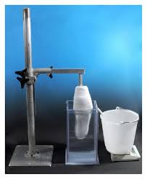
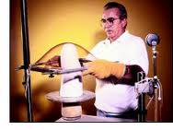
Fabrication & Assembling
Fabrication of interface
Assembling & Alignment basis measurement

Slide 44
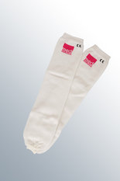
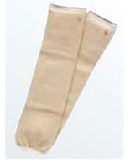
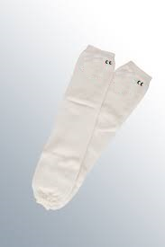
medi Residual limb socks
Protection for liner and residual limb
Indication
Features
Technical specification
Uniform compression
Liner/residual limb protection
Skin friendly
Compensates for residual limb volume fluctuations
Thin end of stockings allows a number of stockings to be worn
Three different variant: nylon, cotton, terry
Highly elastic knit with soft cuffs
Available in pair
Terry: Rs. 1819
Cotton: Rs. 1819
Nylon: Rs. 1684
medi.I feel better

Slide 45
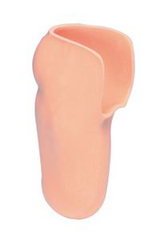
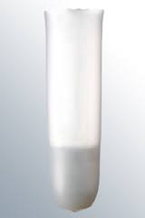
Liner
provide cushioning, provide even pressure distribution, and reduce friction
provide suspension
Connection to rest of prosthesis
Distributes forces along distal component
Copyright © 2015 Pushpanjali medi India Pvt. Ltd. All Rights Reserved

Slide 46
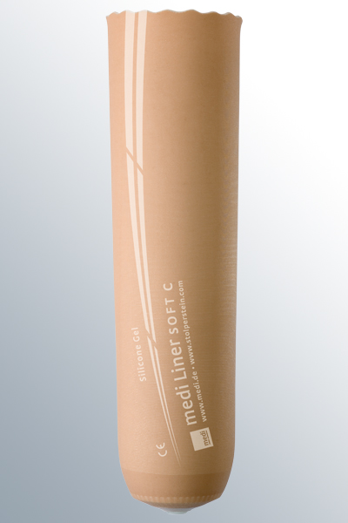
medi Liner SOFT C
Universal liner with textile cover
Indication
Features
Technical specification
Below knee amputation
Mobility class I, I II, III and IV
Length: 35cm
Suspension type: Pin adapter
Easy donning and doffing
Material: silicone ,
Good residual limb condition
Good adhesion and soft tissue stabilization
Rs. 19718
medi.I feel better

Slide 47
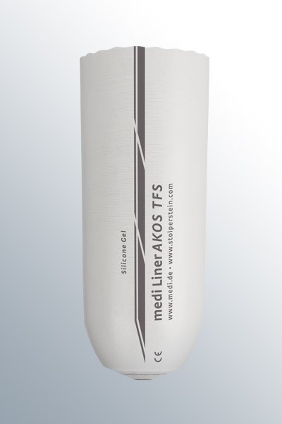
medi Liner AKOS TFS/TFC
Transfemoral liner, without textile cover, with lubricating coating
Indication
Features
Technical specification
Above knee amputation
Mobility class I, I II, III and IV
Length: 35cm
Suspension type: Pin adapter
Easy donning and doffing
Material: silicone ,
Good soft tissue grip
Rs. 22038
medi.I feel better

Slide 48
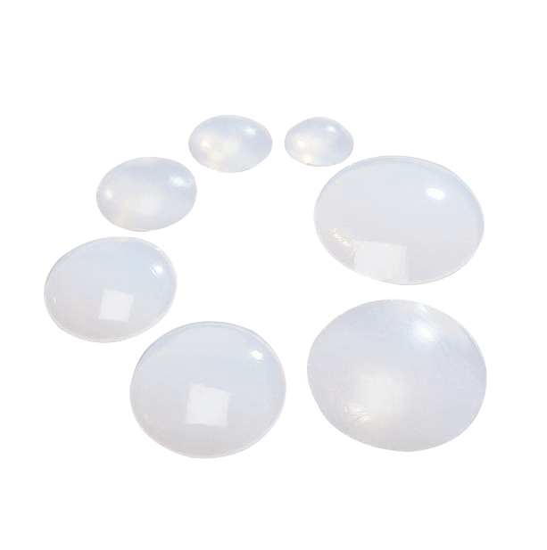
medipro® Liner Silicone pad
better cushioning that facilitates loading of residual limb
cushions condylese in knee disarticulation prostheses
for volume changements in the distal end of the medipro® Liner when decreasing of weight of the patient leads to limb shortages
avoids cavities at the distal end by enlarging the distal surface of liner
Size of medipro®Liner | Ø Silicone pad | Article No
12 – 20 | 37 mm | M.895.138
21 – 23,5 | 45 mm | M.895.148
25 – 28 | 54 mm | M.895.158
30 – 32 | 62 mm | M.895.168
34 – 36 | 70 mm | M.895.178
38 – 42 | 77 mm | M.895.188
45 | 86 mm | M.895.198
medi.I feel better
Copyright © 2015 Pushpanjali medi India Pvt. Ltd. All Rights Reserved

Slide 49


Amputees with phantom pain
What ????
Symptoms
medi solution
Phantom pain is pain that feels like it's coming from a body part that's no longer there, these are basically sensations originate in the spinal cord and brain.
medi relax liner range
Cramping sensation
Umbrellan structure
Shielding action against electromagnetic influence
Shooting sensation
Stabbing sensation
Burning sensation
medi.I feel better
Copyright © 2015 Pushpanjali medi India Pvt. Ltd. All Rights Reserved

Slide 50

medi Liner RELAX 3C
Liner for the relief of phantom pain with textile cover, thicker distal wall
Indication
Features
Technical specification
Below knee amputation
Mobility class I, I II, III and IV
Matrix: 2-zone
Length: 37cm
Durable
Easy donning and doffing
Material: Silicone gel
Phantom pain sensation
Dist. Connection: pin adapter
Reduces phantom pain
Umbrellan structure
Rs. 22148
medi.I feel better

Slide 51



medipro® Liner
RELAX medipro® RELAX Night Care stump sock for the night
Umbrellan® product range
medipro® Liner RELAX TF
transfemoral-liner with coating
medi.I feel better
Copyright © 2015 Pushpanjali medi India Pvt. Ltd. All Rights Reserved

Slide 52


medi IKF adapter
Knee joint adapter for initial knee flexion
Indication
Features
Technical specification
Mobility class I, I II, III and IV
Material:Aluminium
Stimulates physiological knee flexion
Gentle on the residual limb and articular chain
Buffer of varying hardness available
Broad spectrum of use
Weight: 195 gm
Stimulated flexion: 10 º
Rs. 16173
medi.I feel better
Copyright © 2015 Pushpanjali medi India Pvt. Ltd. All Rights Reserved

Slide 53

medi sliding adapter
Adapters for later prosthesis realignment
Indication
Features
Technical specification
Mobility class I, I II, III & IV
Optimisation of prosthesis alignment for trial and definitive prosthesis
Material: Aluminium
Weight: 145 gm
Offsets: 4mm
Weight limit:100-150 kg
Horizontal movement: 11-20cm
Rs. 14275
medi.I feel better
Copyright © 2015 Pushpanjali medi India Pvt. Ltd. All Rights Reserved

Slide 54





Socket adapters
3-arm socket
4-hole adapter with
pyramid
4-hole adapter with
Pyramid receiver
Rs. 8298
Rs. 7439
Rs. 2687
3-arm socket, with pyramid receiver
4-arm socket, with pyramid
Rs. 7439
Rs. 6158
medi.I feel better
Copyright © 2015 Pushpanjali medi India Pvt. Ltd. All Rights Reserved

Slide 55


Tibial adapter
Screw adapter
Rs. 4814
Rs. 4814
Foot adapter
SACH Foot adapter
Rs. 3292
Rs 3292
medi.I feel better
Copyright © 2015 Pushpanjali medi India Pvt. Ltd. All Rights Reserved

Slide 56



medi vaccu valve
Air expulsion valve for vacuum socket system
Indication
Features
Technical specification
Below knee amputation
Mobility class I, I II, III and IV
Weight: 10 gm
Length: 16mm
Simple and quick
Low release pressure required
Two part air expulsion valve
Suitable for: wall thickness 2 to 7 mm
Rs.. 1829
medi.I feel better

Slide 57

medi Genu sleeve
Suspension sleeve for use in a vacuum socket system
Indication
Features
Technical specification
Below knee amputation
Mobility class I, I II, III and IV
Length: 35cm
Suspension type: vacuum
Virtually wrinkle free
Easy donning and doffing
Diabetic, dry, atrophic skin, skin allergy
Highly flexible
Can be used in vacuum suspension
Material: TPE
Airtight fit with the socket
Rs. 4629
medi.I feel better

Slide 58

medi valve set
Helps in vacuum suspension
Indication
Features
Technical specification
Above knee amputation
Mobility class I, I II, III and IV
Weight: 20 gm
material: Plastic
Suitable for: thermoplastic socket
Thermoplastic/lamination socket
Easy application
Safe screw connection
Rs. 7217
medi.I feel better

Slide 59

medi modular clutch lock
For lamination
Indication
Technical specification
Below knee / above knee amputation
Mobility class I, I II, III and IV
Screw move in one way.
Easy donning and doffing
Audible click confirms secure fitting
Alignment within the plumb line
Weight: 100gm
Airtight fit with the socket
Fitted height: 40 mm
Pin length: 50mm
Features
Rs. 13226
medi modular clutch lock
medi.I feel better

Slide 60






Final Product

Slide 61




Rehabilitation training
GAIT training
Parallel bars
Stairs & Ramp
Bio-Feedback

Slide 62


